Slide 1
Presentation
Alpha Sprint

Slide 2
01
/ Project Membership Division and Expected Plan
02
/ Actual progress curve, burnout chart of the project
03
/ Problems and solutions
04
/ The actual architecture of the project
05
/ project testing schedule, test tool selection and use, project testing review
06
/ Members' process experience
Catalog

Slide 3
01
Project Membership Division and Expected Plan

Slide 4
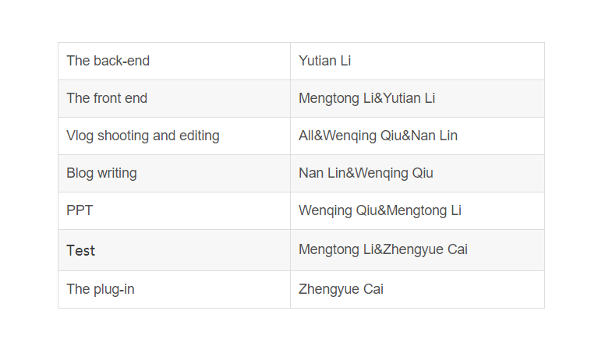
Division of labour

Slide 5
Expected Plan
Complete basic crawler, java backend authentication and sending tokens for logged in users, and some front end

Slide 6
02
Burn Down Chart

Slide 7
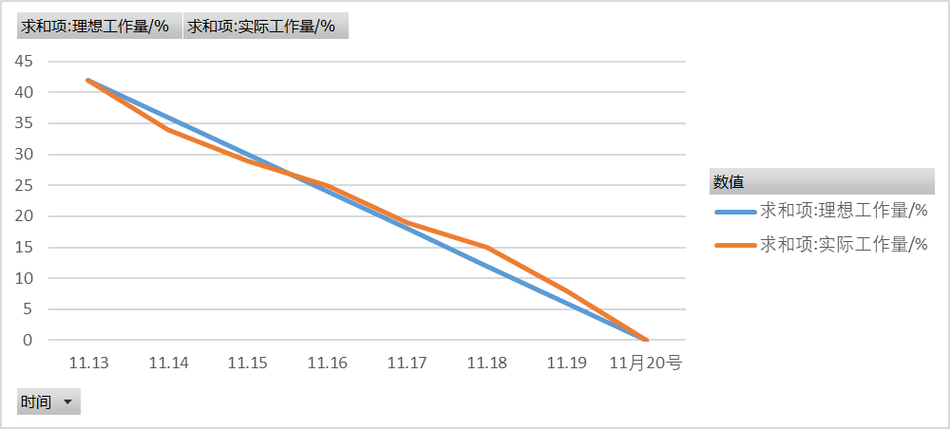

Slide 8
03
Poblems And How to Solution Them

Slide 9
problems
solution
The avatar and nickname you get when logging in are anonymous | Change to a new access method
Avatar size cannot be changed | No solution has been worked out yet due to time constraints
Pages are blocked when pagination is displayed | No method found
tabber click invalid | Checking information combined with experience

Slide 10
04
The Actual Architecture of The Project

Slide 11
The Actual Architecture of The Project
Back End
front end
uses mpvue, vuecli scaffolding
The backend uses a distributed architecture of Eureka microservices with springcloud nested in springboot. The gateway uses a security policy of springsecurity plus redis plus jwt plus springAop. The gateway and sub-tier between the use of feign configuration load balancing and service requests. The database framework is mybatis-plus. using the quartz subproject to python crawler timing calls. The calls to the plugins are made using runningtime
UI
iview weapp
Plugins
mysql,sqlyog,dlib,Beautiful Soup

Slide 12
05
Project Testing

Slide 13
project testing schedule
Finished testing the login modulation
test connection tool
postman and docway
test code rate
using jacoco
On-going

Slide 14
06
Members' process experience

Slide 15



Yutian Li : I learned a lot of knowledge that I didn't know before.At the same time, I also strengthened the contact with team members and improved my communication skills.
Zhengyue Cai : I learned a little bit about the back end and plug-ins.This project greatly improved my self-learning ability and my ability to communicate with teammates.
Wenqing Qiu : I didn't know much about the front end and back end before this project, but with the progress of this project, I gradually learned some knowledge.This project also helped me learn how to use tools to make prototype design.
Mengtong Li : Before this project, I didn't have much front-end technology involved.But through this project, I found a lot of information on the Internet, and learned a lot of front-end knowledge.This also enabled me to communicate closely with classmates who were also in charge of the front end, and strengthened the connection between me and my teammates.
Nan Lin : Before this experiment, I didn't have much contact with the front and back end technology, but through this experiment, I learned some knowledge.As the team leader this time, I had to divide the labor for everyone, which made me know more about my team members and improved my communication skills.

Slide 16
Thanks for Watching

